Slide 1


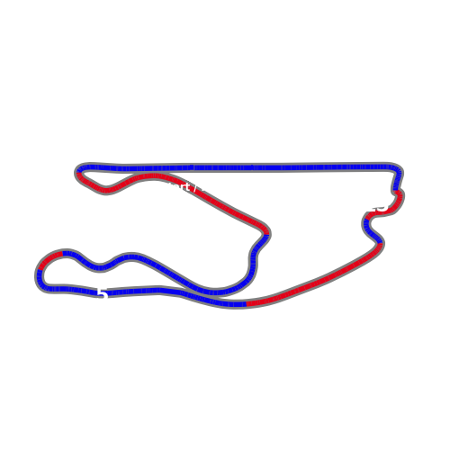
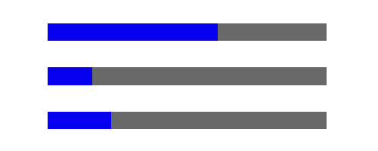

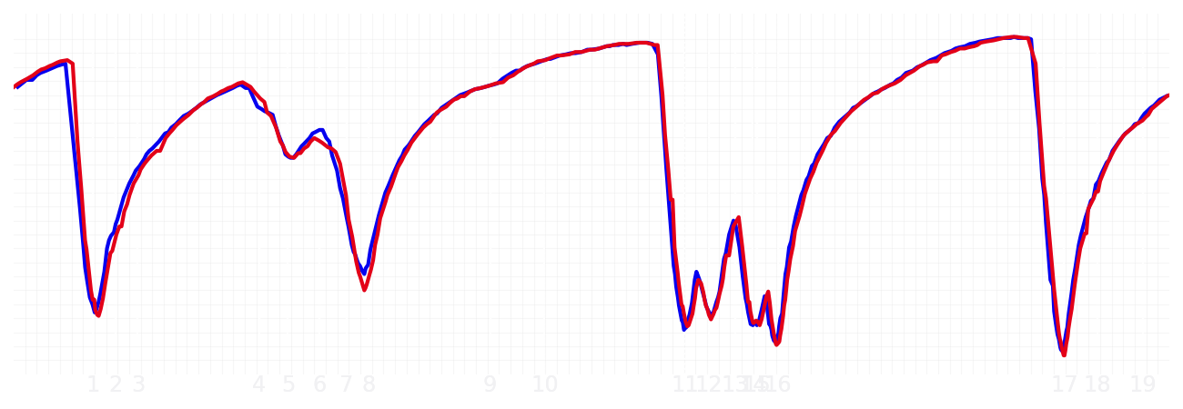
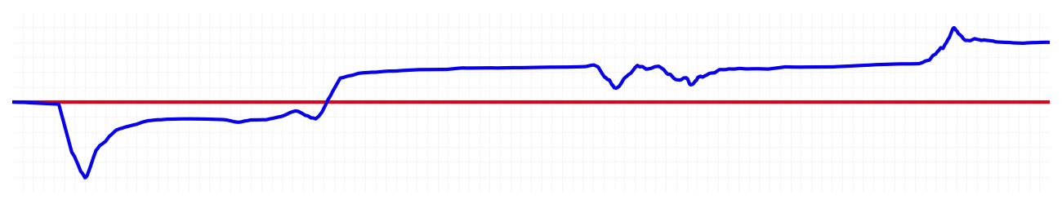
Miami GP Qualifying Q1
Max Verstappen
Driver
Yuki Tsunoda
Driver
Lap Time
01:26.870
01:27.298
Lap Time
Sector 1
28.413
Speed Trap 1
223 kp/h
Speed Trap 1
221 kp/h
Sector 1
28.796
Sector 2
33.450
Speed Trap 2
191 kp/h
Gap
-0.428
Gap
0.428
Speed Trap 2
190 kp/h
Sector 2
33.451
Sector 3
25.007
Speed Final Line
286 kp/h
Corner Advantage
8/20
Corner Advantage
12/20
Speed Final Line
285 kp/h
Sector 3
25.051
FULL THROTTLE
61%
58%
FULL THROTTLE
HEAVY BREAKING
16%
17%
HEAVY BREAKING
%LAP TIME
CORNERING
23%
25%
CORNERING
%LAP TIME
SPEED
SPEED
DELTA TIME
DELTA TIME

Slide 2

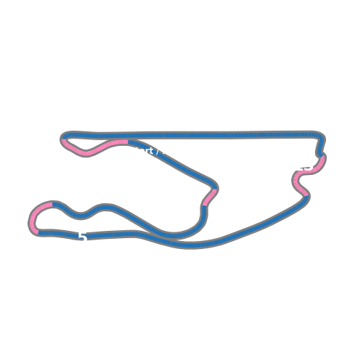


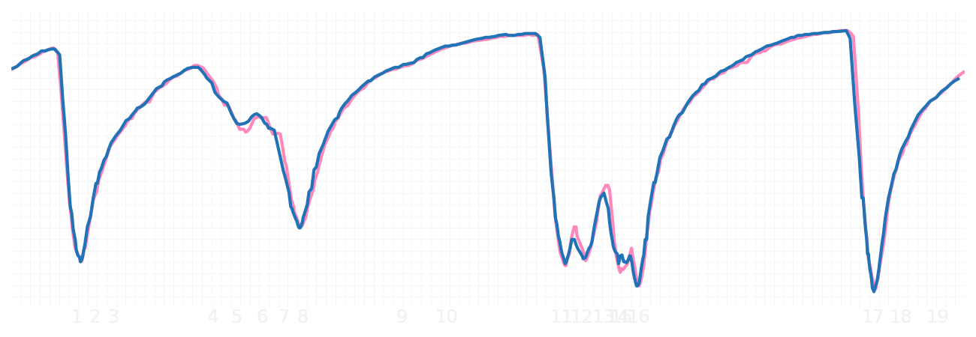
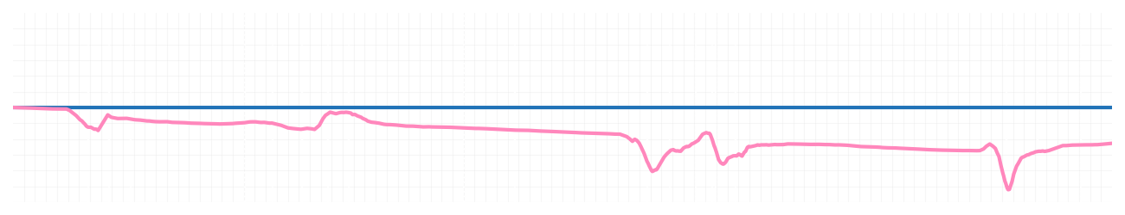
Miami GP Qualifying Q1
Pierre Gasly
Driver
Jack Doohan
Driver
Lap Time
01:27.710
01:27.422
Lap Time
Sector 1
28.962
Speed Trap 1
221 kp/h
Speed Trap 1
222 kp/h
Sector 1
28.744
Sector 2
33.714
Speed Trap 2
191 kp/h
Gap
0.288
Gap
-0.288
Speed Trap 2
191 kp/h
Sector 2
33.660
Sector 3
25.034
Speed Final Line
288 kp/h
Corner Advantage
11/20
Corner Advantage
9/20
Speed Final Line
287 kp/h
Sector 3
25.018
FULL THROTTLE
60%
57%
FULL THROTTLE
HEAVY BREAKING
18%
16%
HEAVY BREAKING
%LAP TIME
CORNERING
22%
27%
CORNERING
%LAP TIME
SPEED
SPEED
DELTA TIME
DELTA TIME

Slide 3

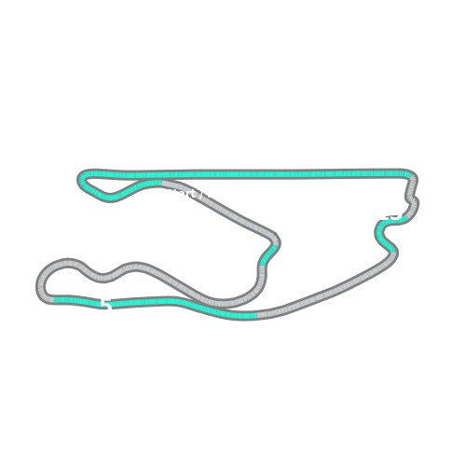


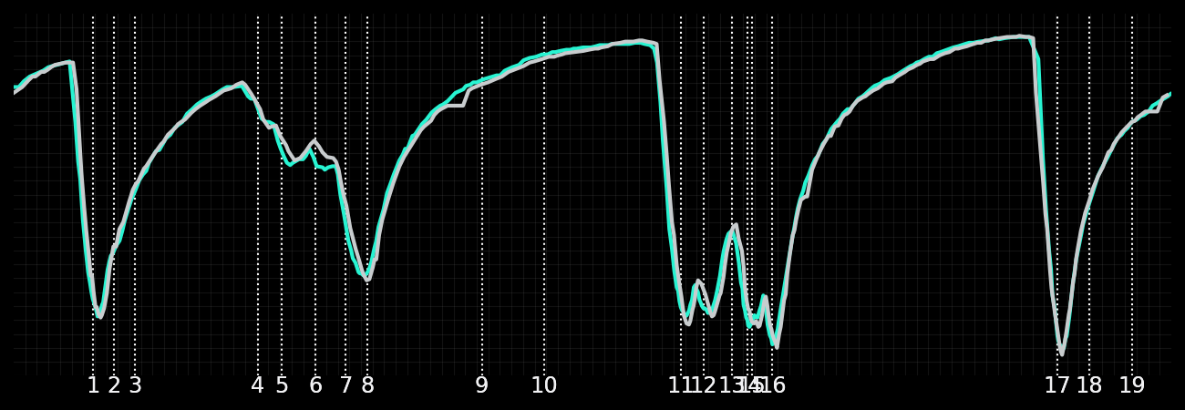
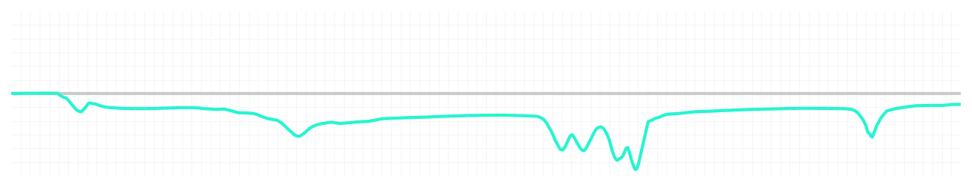
Miami GP Qualifying Q1
Kimi Antonelli
Driver
George Russell
Driver
Lap Time
01:27.077
01:27.014
Lap Time
Sector 1
28.627
Speed Trap 1
221 kp/h
Speed Trap 1
222 kp/h
Sector 1
28.674
Sector 2
33.551
Speed Trap 2
192 kp/h
Gap
0.063
Gap
-0.063
Speed Trap 2
192 kp/h
Sector 2
33.483
Sector 3
24.899
Speed Final Line
287 kp/h
Corner Advantage
20/20
Corner Advantage
0/20
Speed Final Line
288 kp/h
Sector 3
24.857
FULL THROTTLE
58%
0%
FULL THROTTLE
HEAVY BREAKING
17%
0%
HEAVY BREAKING
%LAP TIME
CORNERING
25%
100%
CORNERING
%LAP TIME
SPEED
SPEED
DELTA TIME
DELTA TIME

Slide 4

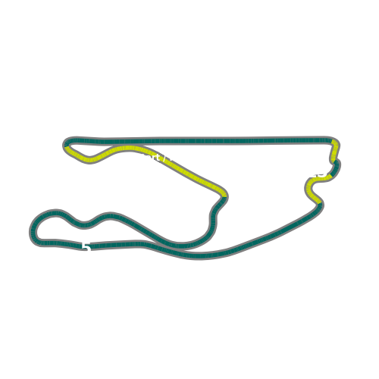


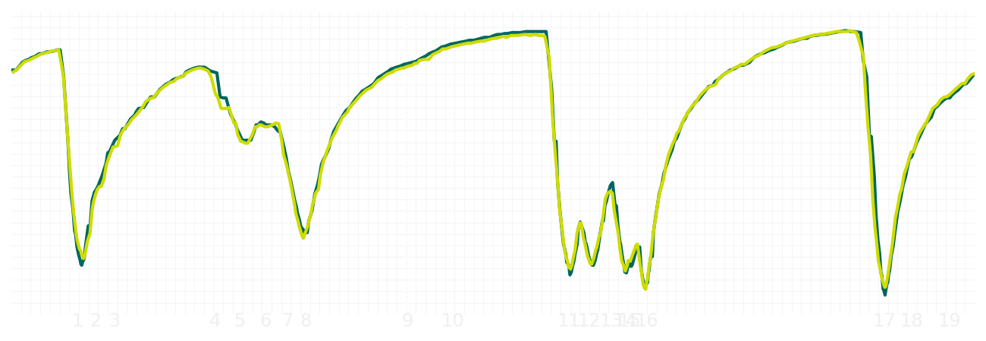
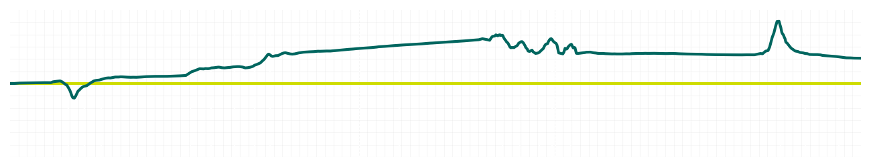
Miami GP Qualifying Q1
Fernando Alonso
Driver
Lance Stroll
Driver
Lap Time
01:27.604
01:27.830
Lap Time
Sector 1
28.851
Speed Trap 1
219 kp/h
Speed Trap 1
216 kp/h
Sector 1
29.106
Sector 2
33.868
Speed Trap 2
192 kp/h
Gap
-0.226
Gap
0.226
Speed Trap 2
191 kp/h
Sector 2
33.837
Sector 3
24.885
Speed Final Line
286 kp/h
Corner Advantage
8/20
Corner Advantage
12/20
Speed Final Line
288 kp/h
Sector 3
24.887
FULL THROTTLE
58%
60%
FULL THROTTLE
HEAVY BREAKING
18%
17%
HEAVY BREAKING
%LAP TIME
CORNERING
24%
23%
CORNERING
%LAP TIME
SPEED
SPEED
DELTA TIME
DELTA TIME

Slide 5

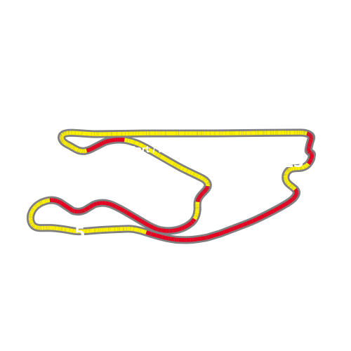


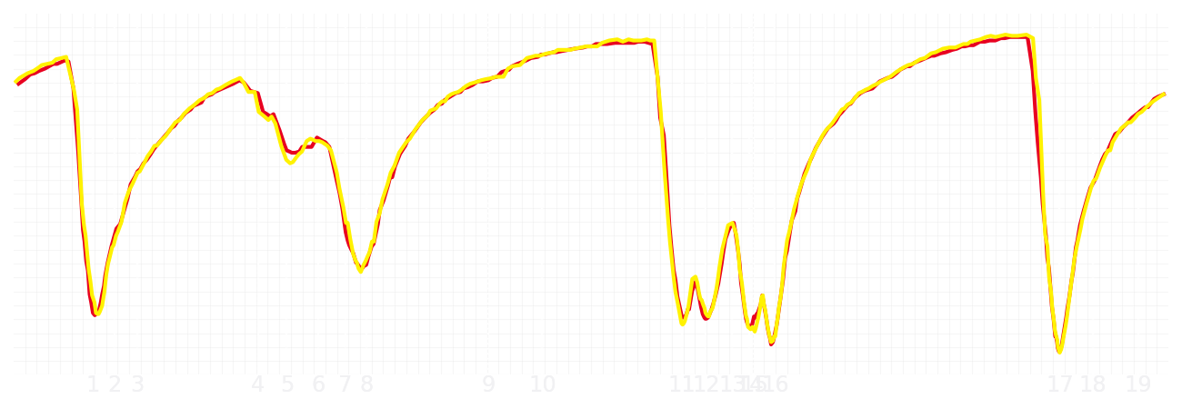
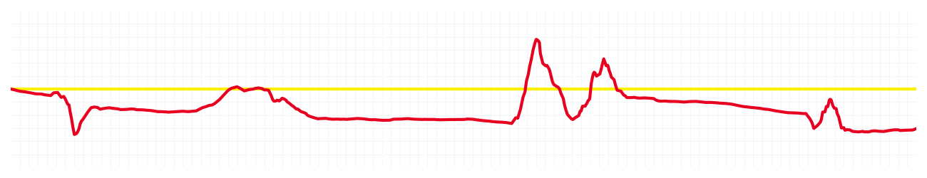
Miami GP Qualifying Q1
Charles Leclerc
Driver
Lewis Hamilton
Driver
Lap Time
01:27.417
01:27.279
Lap Time
Sector 1
28.861
Speed Trap 1
221 kp/h
Speed Trap 1
223 kp/h
Sector 1
28.734
Sector 2
33.559
Speed Trap 2
192 kp/h
Gap
0.138
Gap
-0.138
Speed Trap 2
194 kp/h
Sector 2
33.597
Sector 3
24.997
Speed Final Line
286 kp/h
Corner Advantage
9/20
Corner Advantage
11/20
Speed Final Line
286 kp/h
Sector 3
24.948
FULL THROTTLE
56%
57%
FULL THROTTLE
HEAVY BREAKING
20%
20%
HEAVY BREAKING
%LAP TIME
CORNERING
24%
23%
CORNERING
%LAP TIME
SPEED
SPEED
DELTA TIME
DELTA TIME

Slide 6

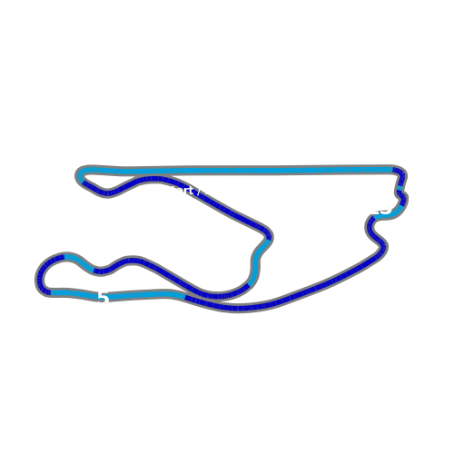


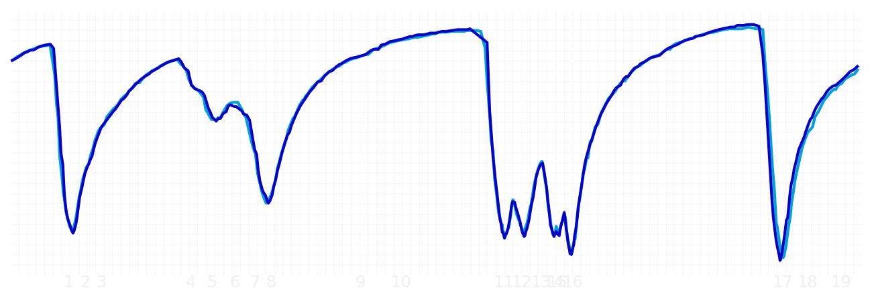
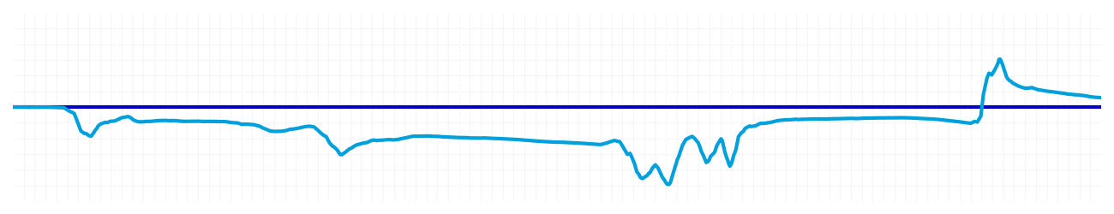
Miami GP Qualifying Q1
Alexander Albon
Driver
Carlos Sainz
Driver
Lap Time
01:27.042
01:27.098
Lap Time
Sector 1
28.990
Speed Trap 1
223 kp/h
Speed Trap 1
224 kp/h
Sector 1
28.887
Sector 2
33.240
Speed Trap 2
192 kp/h
Gap
-0.056
Gap
0.056
Speed Trap 2
193 kp/h
Sector 2
33.383
Sector 3
24.812
Speed Final Line
286 kp/h
Corner Advantage
13/20
Corner Advantage
7/20
Speed Final Line
288 kp/h
Sector 3
24.828
FULL THROTTLE
56%
56%
FULL THROTTLE
HEAVY BREAKING
19%
17%
HEAVY BREAKING
%LAP TIME
CORNERING
25%
27%
CORNERING
%LAP TIME
SPEED
SPEED
DELTA TIME
DELTA TIME

Slide 7

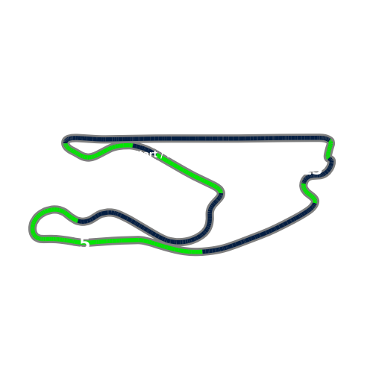


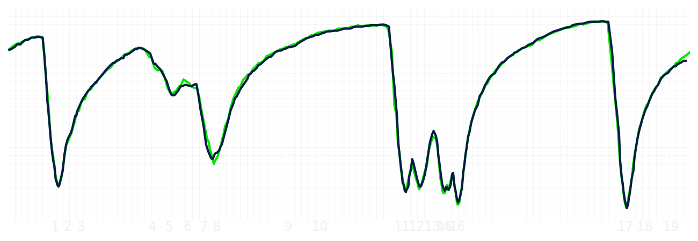
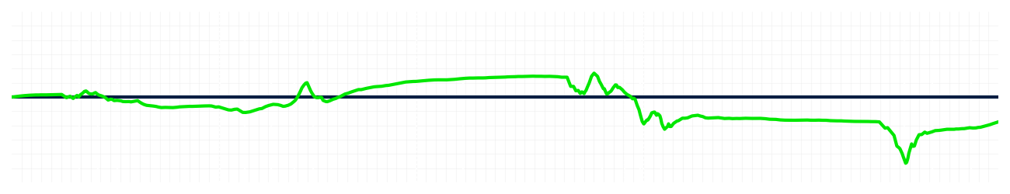
Miami GP Qualifying Q1
Nico Hulkenberg
Driver
Gabriel Bortoleto
Driver
Lap Time
01:27.473
01:27.343
Lap Time
Sector 1
28.781
Speed Trap 1
224 kp/h
Speed Trap 1
219 kp/h
Sector 1
28.887
Sector 2
33.747
Speed Trap 2
192 kp/h
Gap
0.13
Gap
-0.13
Speed Trap 2
193 kp/h
Sector 2
33.537
Sector 3
24.945
Speed Final Line
288 kp/h
Corner Advantage
9/20
Corner Advantage
11/20
Speed Final Line
282 kp/h
Sector 3
24.919
FULL THROTTLE
58%
59%
FULL THROTTLE
HEAVY BREAKING
19%
16%
HEAVY BREAKING
%LAP TIME
CORNERING
23%
25%
CORNERING
%LAP TIME
SPEED
SPEED
DELTA TIME
DELTA TIME

Slide 8

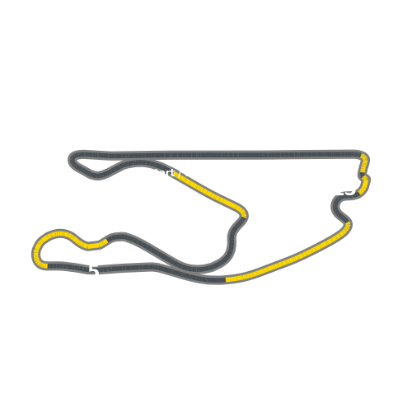


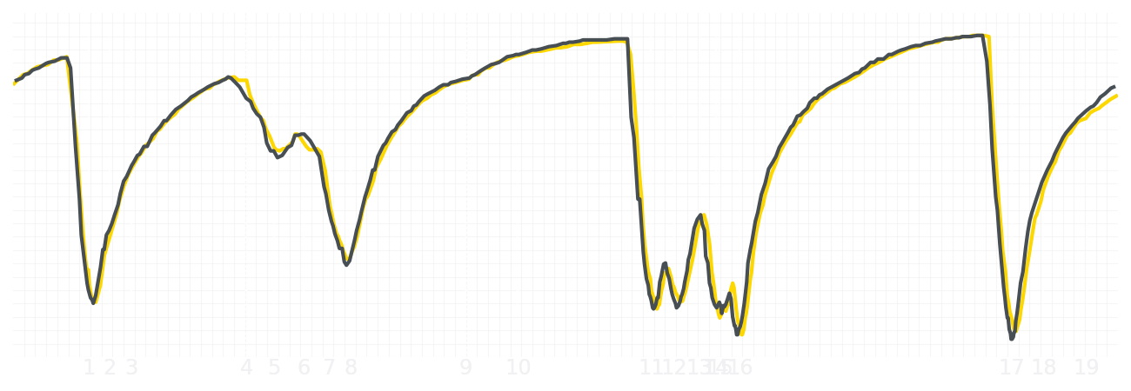
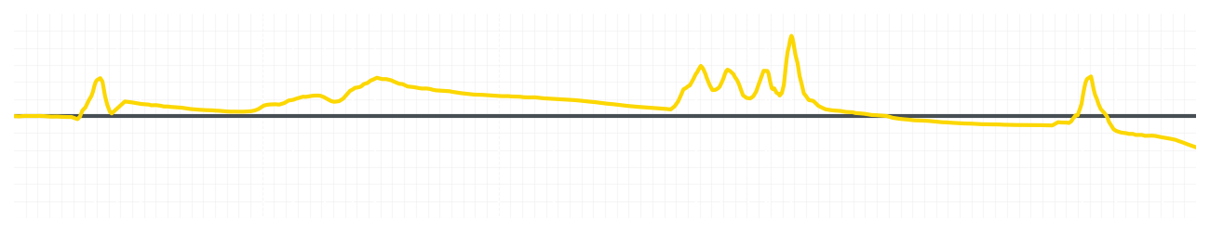
Miami GP Qualifying Q1
Liam Lawson
Driver
Isack Hadjar
Driver
Lap Time
01:27.444
01:27.301
Lap Time
Sector 1
28.748
Speed Trap 1
224 kp/h
Speed Trap 1
222 kp/h
Sector 1
28.759
Sector 2
33.647
Speed Trap 2
192 kp/h
Gap
0.143
Gap
-0.143
Speed Trap 2
191 kp/h
Sector 2
33.531
Sector 3
25.049
Speed Final Line
280 kp/h
Corner Advantage
12/20
Corner Advantage
8/20
Speed Final Line
287 kp/h
Sector 3
25.011
FULL THROTTLE
56%
58%
FULL THROTTLE
HEAVY BREAKING
19%
17%
HEAVY BREAKING
%LAP TIME
CORNERING
25%
25%
CORNERING
%LAP TIME
SPEED
SPEED
DELTA TIME
DELTA TIME

Slide 9

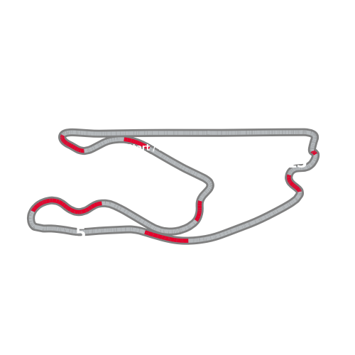


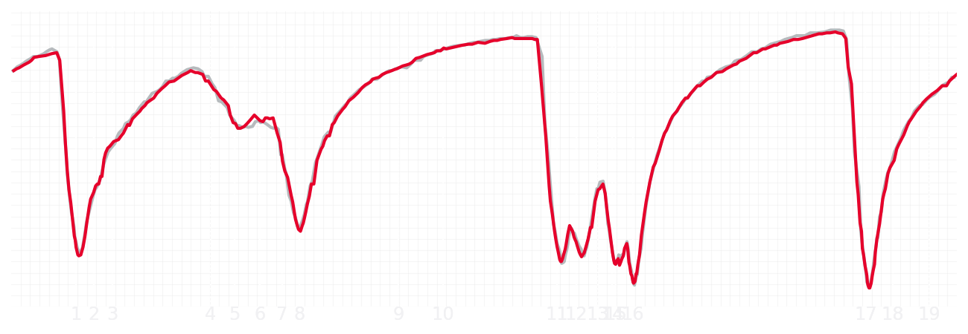
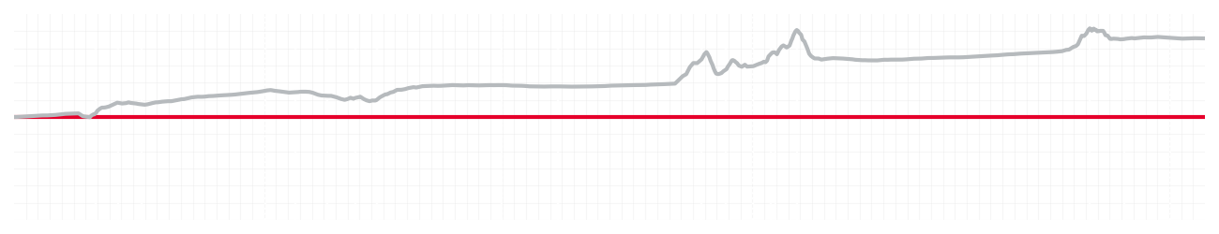
Miami GP Qualifying Q1
Esteban Ocon
Driver
Ollie Bearman
Driver
Lap Time
01:27.450
01:27.999
Lap Time
Sector 1
28.945
Speed Trap 1
223 kp/h
Speed Trap 1
219 kp/h
Sector 1
29.116
Sector 2
33.573
Speed Trap 2
194 kp/h
Gap
-0.549
Gap
0.549
Speed Trap 2
192 kp/h
Sector 2
33.765
Sector 3
24.932
Speed Final Line
286 kp/h
Corner Advantage
9/20
Corner Advantage
11/20
Speed Final Line
286 kp/h
Sector 3
25.118
FULL THROTTLE
58%
59%
FULL THROTTLE
HEAVY BREAKING
20%
20%
HEAVY BREAKING
%LAP TIME
CORNERING
22%
21%
CORNERING
%LAP TIME
SPEED
SPEED
DELTA TIME
DELTA TIME

Slide 10

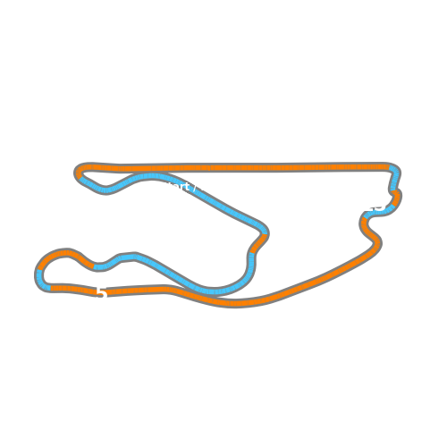


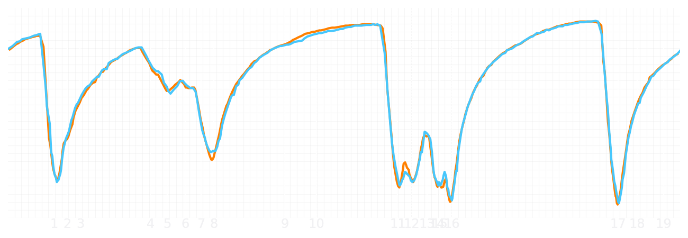
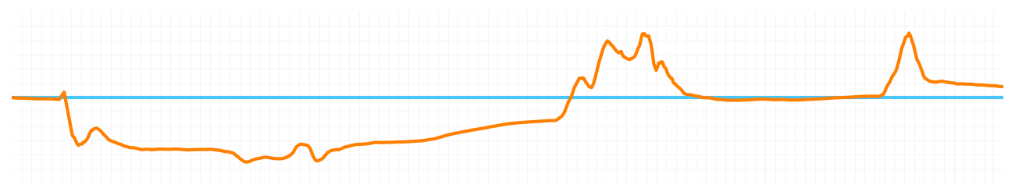
Miami GP Qualifying Q1
Lando Norris
Driver
Oscar Piastri
Driver
Lap Time
01:26.955
01:27.006
Lap Time
Sector 1
28.800
Speed Trap 1
221 kp/h
Speed Trap 1
219 kp/h
Sector 1
28.671
Sector 2
33.377
Speed Trap 2
192 kp/h
Gap
-0.051
Gap
0.051
Speed Trap 2
192 kp/h
Sector 2
33.468
Sector 3
24.778
Speed Final Line
287 kp/h
Corner Advantage
11/20
Corner Advantage
9/20
Speed Final Line
287 kp/h
Sector 3
24.867
FULL THROTTLE
58%
58%
FULL THROTTLE
HEAVY BREAKING
14%
13%
HEAVY BREAKING
%LAP TIME
CORNERING
28%
29%
CORNERING
%LAP TIME
SPEED
SPEED
DELTA TIME
DELTA TIME

